Slide 1

DAB 103 Analytics Tools and Decision-Making Project

Slide 2

Team Introduction
Group No: 11
Section no: 003
Team Members
Dilpreet Singh
Amninder Singh
Manjot Singh Gill
Inderpreet Singh
Navjot Singh

Slide 3
Background & Motivation
Background:
The Tennessee General Assembly funded by the State Department of Education who conducted the Project Star, a four-year longitudinal class-size study featuring over 7,000 pupils across 79 schools and with three interventions: Regular class (13 to 17 students per instructor), small class (13 to 17 students per teacher) (22 to 25 students per teacher) and regular-with-aide class (22 to 25 students with a full-time teacher's aide). [3]
Motivation: This research will elucidate the characteristics of the educational system all over the world; just by lowering classroom sizes, the school curriculum will benefit by improving student’s productivity. [6]
It will assist any emerging nation by simply adopting a comparable system; it will help throughout every sector since the method has been tried and proven to be effective. The school education system will be the incentive to perform in the several sectors to accomplish the task and implement the same thing we are aiming to discuss in this research.
Lastly, we appreciate any improvement that is implemented in any component. It will improve any educational system in a growing country.

Slide 4
Problem Statement
The major goal is to identify the elements that have a direct influence on student grades in different classrooms. This dataset contains a wealth of information that may be used to compare and analyze various student-teacher accomplishment ratios. [1]
Further Insights: The study spanned four years and involved a single cohort of kids who went from kindergarten through third grade.
Annually, achievement exams and non-achievement assessments are granted publicly & the study ended in 1989. However, student performance data was collected through high school, and additional non-achievement factors were added to the data set because of supplementary research. [6]

Slide 5
Target Audience
School Administration:
Our primary objective encourages us to execute the task in a methodical manner for the school system. [3]
We will investigate every sector from this dataset, beginning with early childhood education and progressing through middle school, to gain a clear picture of what we'd like to visualize the complete dataset.
It will greatly assist us in carrying out our research, which will result in the creation of a picture of analysis.
The correlation of variables will aid in determining which variables are inextricably linked to one another and which have the potential to affect the pupil’s output.

Slide 6
Insights to gain from Data
How does the class size impact student marks?
What is the impact of class size on different subjects like mathematics and reading?
What is the impact of class size on student marks across different grades?
Which school types are benefitted from smaller class size?
Which ethnicities are benefitted from smaller class size?
How does the educational qualifications of teacher affect the student marks?
What is the impact of teacher's career ladder level on the student marks?
What is the relationship between teacher's total teaching experience and student marks?
Do students benefit from being taught by the teacher of same ethnicity ?
Is a particular gender more benefitted from a smaller class size?

Slide 7
Project Proposal
We will make a comprehensive descriptive analysis that will assist everyone in grasping how education could be benefited from our computations and charts that illustrate student productivity based on various aspects during the school year.
Using the python code in this dataset, we will create charts and offer insights.

Slide 8

Dataset Description
Our dataset is totally utilized for Descriptive Analysis:
The entire analysis is based on The Student & Teacher Achievement Ratio (STAR) and it obtained from Online complements to Stock and Watson (2007))
It includes information on 11,601 students and 79 schools during the 1995-1996 school year.
• Demographic variables • School and class identifiers • School and teacher information • Experimental condition (“class type”) • Norm-referenced and criterion-referenced achievement test scores • Motivation and self-concept scores.

Slide 9

GitHub Repo. & Dataset weblinks.
GitHub Repository:
https://github.com/dilpresingh/dab103-project/blob/main/project-submission-1.ipynb
The final python file is uploaded by one of our group member on GitHub Repository.
Weblink to the dataset:
https://rdrr.io/cran/AER/man/STAR.html
Source:
Online complements to Stock and Watson (2007).
References:
Stock, J.H. and Watson, M.W. (2007). Introduction to Econometrics, 2nd ed. Boston: Addison Wesley.

Slide 10

Future Transformation Steps:
Cleaning the data & the redundant Column :
Columns in a Data Frame Could Be Erased.
Changing a Data Frame's Index.
Using str Methods in conjunction with NumPy to Clean Columns.
Using the apply map Function, clean the entire dataset.
Column renaming and row skipping.
Removing Null or N/A Values and Duplicates :
The dropna() method in Pandas DataFrame is used to eliminate rows and columns containing Null/NaN values.
Syntax: DataFrame.dropduplicates. It is used not delete the duplicates values.
Removing Outliers:
To remove the outlier, follow the same procedure as deleting an entry from the dataset using its specific location in the dataset, since the end result of all the aforementioned ways of identifying outliers is a list of all those data items that satisfy the outlier description according to the method employed.

Slide 11
Inclusion Criteria
The Total students who took participation in this research was over 7,000 and they all are from 79 institutes.
The study begun from kindergarten and end at third grade.
The whole process executed during the 1995-1996 school year
It contain three different interventions :
Small Class
Regular Class
Regular- with-aside
Two subjects are purely focused:
Reading
Math
Most teachers and students are from different ethnicity:
Caucasian (“cauc”) (Teachers and Students)
African-American (“afam”) (Teachers and Students)
Asian (“Asian”)
Hispanic (“hispanic”)
American-Indian (“amindian”)

Slide 12
Dataset Schema
Categorical Variable
Gender
Ethnicity
Birth
StarK
Star1
Star2
Star3
LunchK
Lunch1
Lunch 2
Lunch3
DegreeK
Degree1
Degree2
Degree3
LadderK
Ladder1
Ladder2
Ladder3
TethnicityK
Tethnicity1
Tethnicity2
Technicity3
Project Star
Numerical
Variable
ReadK
Read1
Read2
Read3
MathK
Math1
Math2
Math3
ExperienceK
Experience1
Experience2
Experience3
SystemK
System1
System2
System3
SchoolIdK
Schoolid1
Schoolid2
Schoolid3
Index Variable

Slide 13
Description of all Variables:
Gender: factor indicating student's gender.
Ethnicity: factor indicating student's ethnicity with levels "cauc" (Caucasian), "afam" (African-American), "asian" (Asian), "hispanic" (Hispanic), "amindian" (American-Indian) or "other".
Birth: student's birth quarter (of class yearqtr).
Stark: factor indicating the STAR class type in kindergarten: regular, small, or regular-with-aide. NA indicates that no STAR class was attended.
Star1: factor indicating the STAR class type in 1st grade: regular, small, or regular-with-aide. NA indicates that no STAR class was attended.
Star2: factor indicating the STAR class type in 2nd grade: regular, small, or regular-with-aide. NA indicates that no STAR class was attended.
Star3: factor indicating the STAR class type in 3rd grade: regular, small, or regular-with-aide. NA indicates that no STAR class was attended.
Readk: total reading scaled score in kindergarten.
Read1: total reading scaled score in 1st grade.
Read2: total reading scaled score in 2nd grade.
Read3: total reading scaled score in 3rd grade.
Mathk: total math scaled score in kindergarten.
Math1: total math scaled score in 1st grade.
Math2: total math scaled score in 2nd grade.
Math3: total math scaled score in 3rd grade.

Slide 14
Description of all Variables:
16. lunchk: factor indicating whether the student qualified for free lunch in kindergarten.
17. lunch1: factor indicating whether the student qualified for free lunch in 1st grade.
18. lunch2: factor indicating whether the student qualified for free lunch in 2nd grade.
19. lunch3: factor indicating whether the student qualified for free lunch in 3rd grade.
20. schoolk: factor indicating school type in kindergarten: "inner-city", "suburban", "rural" or "urban".
21. school1: factor indicating school type in 1st grade: "inner-city", "suburban", "rural" or "urban".
22. School2: factor indicating school type in 2nd grade: "inner-city", "suburban", "rural" or "urban".
23. school3: factor indicating school type in 3rd grade: "inner-city", "suburban", "rural" or "urban".
24. degreek: factor indicating highest degree of kindergarten teacher: "bachelor", "master", "specialist", or "master+".
25. degree1: factor indicating highest degree of 1st grade teacher: "bachelor", "master", "specialist", or "phd".
26. degree2 :factor indicating highest degree of 2nd grade teacher: "bachelor", "master", "specialist", or "phd".
27. degree3: factor indicating highest degree of 3rd grade teacher: "bachelor", "master", "specialist", or "phd".
28. ladderk: factor indicating teacher's career ladder level in kindergarten: "level1", "level2", "level3", "apprentice", "probation" or "pending".
29. ladder1:factor indicating teacher's career ladder level in 1st grade: "level1", "level2", "level3", "apprentice", "probation" or "noladder".
30. ladder2:factor indicating teacher's career ladder level in 2nd grade: "level1", "level2", "level3", "apprentice", "probation" or "noladder".

Slide 15
Description of all Variables:
31. ladder3: factor indicating teacher's career ladder level in 3rd grade: "level1", "level2", "level3", "apprentice", "probation" or "noladder".
32. experiencek: years of teacher's total teaching experience in kindergarten.
33. experience1: years of teacher's total teaching experience in 1st grade.
34. experience2: years of teacher's total teaching experience in 2nd grade.
35. experience3: years of teacher's total teaching experience in 3rd grade.
36. tethnicityk: factor indicating teacher's ethnicity in kindergarten with levels "cauc" (Caucasian) or "afam" (African-American).
37. tethnicity1: factor indicating teacher's ethnicity in 1st grade with levels "cauc" (Caucasian) or "afam" (African-American).
38. tethnicity2: factor indicating teacher's ethnicity in 2nd grade with levels "cauc" (Caucasian) or "afam" (African-American).
39. tethnicity3: factor indicating teacher's ethnicity in 3rd grade with levels "cauc" (Caucasian), "afam" (African-American), or "asian" (Asian).
40. systemk: factor indicating school system ID in kindergarten.
41. system1: factor indicating school system ID in 1st grade.
42. system2: factor indicating school system ID in 2nd grade.
43. system3: factor indicating school system ID in 3rd grade.
44. schoolidk: factor indicating school ID in kindergarten.
45. schoolid1: factor indicating school ID in 1st grade.
46. schoolid2: factor indicating school ID in 2nd grade.
47. schoolid3: factor indicating school ID in 3rd grade.

Slide 16
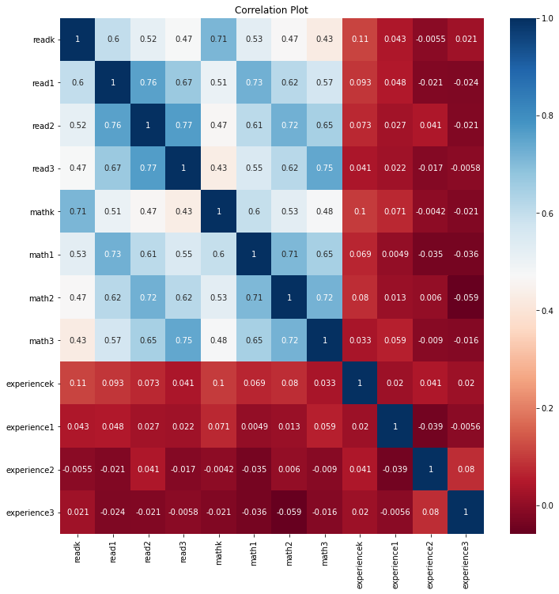
Correlation Plot
Correlation Coefficient = +1: A perfect positive relationship. (Dark Blue)
Correlation Coefficient = 0.8: A strong positive relationship (Blue)
Correlation Coefficient = 0.6: A moderate positive relationship. (Light Blue)
Correlation Coefficient = 0: No relationship.
As one value increases, there is no tendency for the other value to change in a specific direction.
(Light Red / Carrot)
Correlation Coefficient = -1: A perfect negative relationship. (Red)

Slide 17
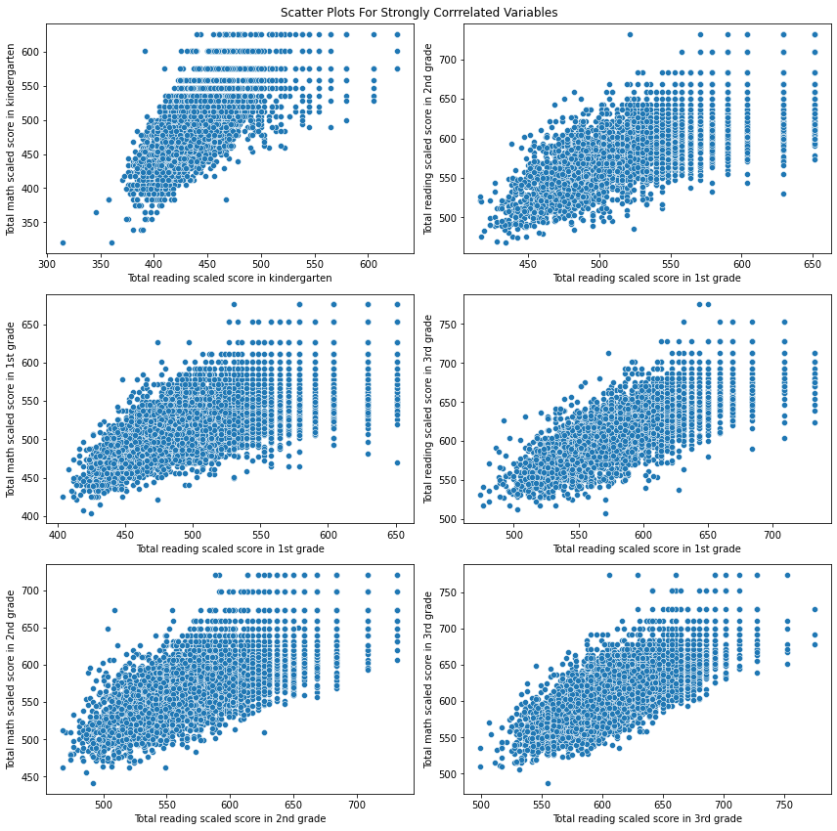
Scatter Plots For Strongly Correlated Variables

Slide 18
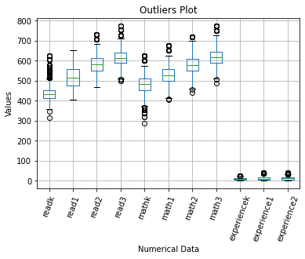
Outliers:
Readk to Math3 have outlier's data, except read 1.

Slide 19
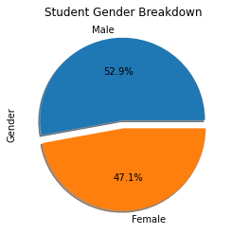
Categorical analysis
Students Gender
Breakdown in the entire dataset.

Slide 20
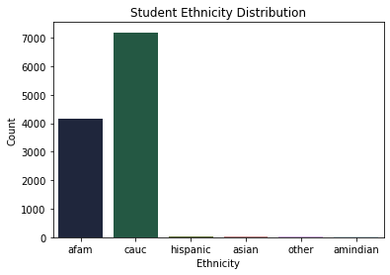
Student Ethnicity distribution represents that Highest number of students are “Cauc”
, followed by “afam”

Slide 21
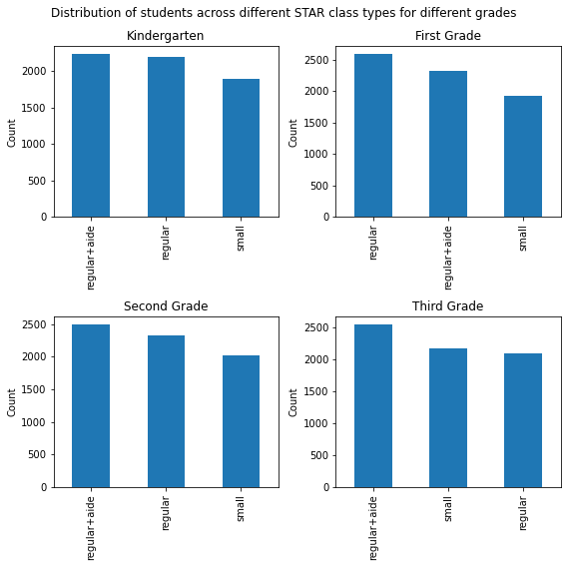
Plot:
Distribution of students across class type for different grades
Kindergarten, second and third grades has
most students from regular + aid
however, first grade has mostly from regular Classroom.

Slide 22
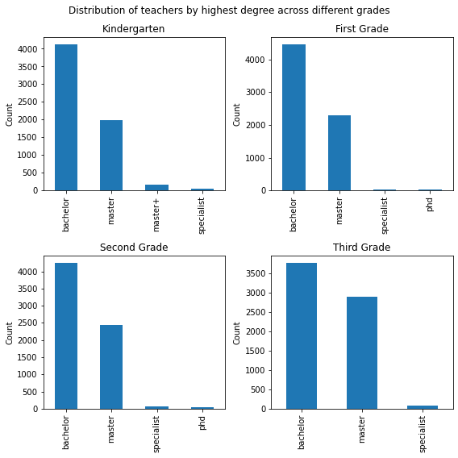
Plot:
Teachers' highest degree across different Grades.
As the graphs represents the most common degree across all grades is “Bachelor's”

Slide 23
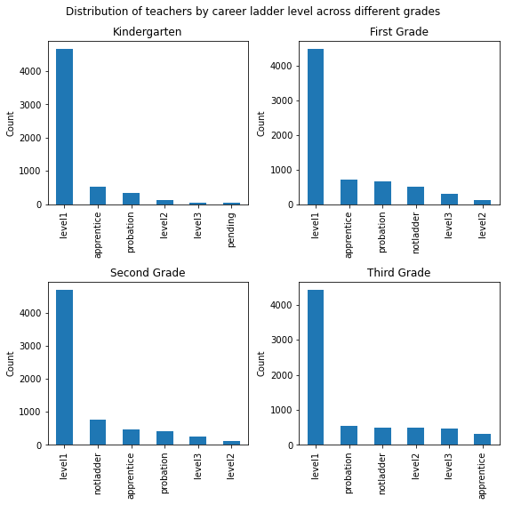
Plot:
Teachers career ladder level
across different grades
Most teacher’s are at career level 1 across all grades

Slide 24
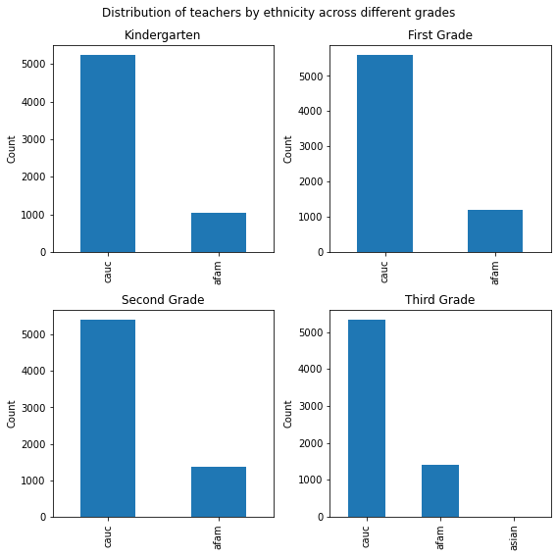
Plot:
Teachers' ethnicity across
different grades
“Cauc” ethnicity category is the highest category among all grades.

Slide 25
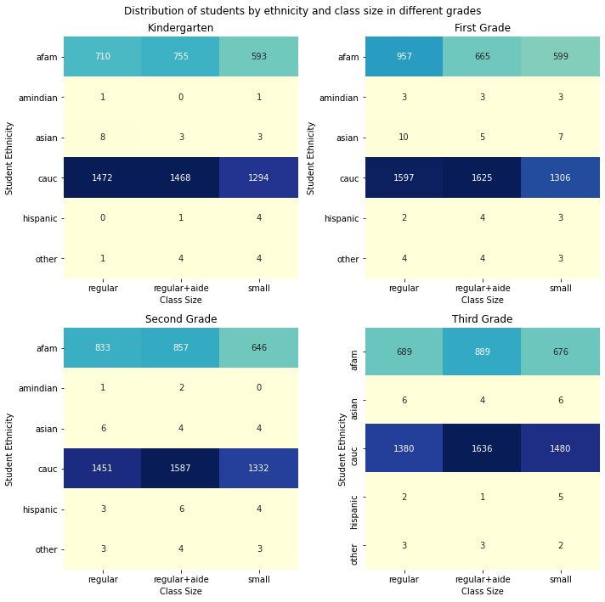
Plot:
Distribution of students by ethnicity and class size in different grades.
In this graph, ethnicity category of “Cauc” is the highest across all class sizes.

Slide 26
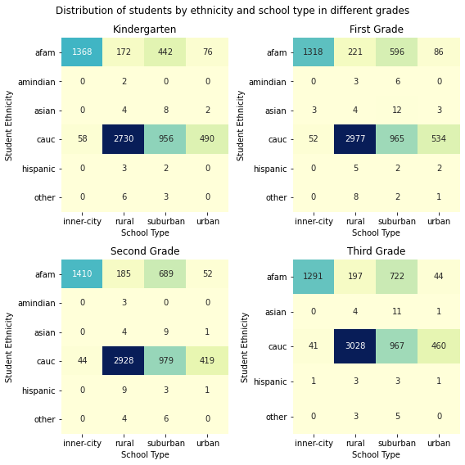
Plot:
Distribution of student's ethnicity by school type
In different grades.
Rural , sub urban & urban categories were the one’s where “cauc” ethnicity students were the highest.
However, In Inner city “afam” students were highest.

Slide 27
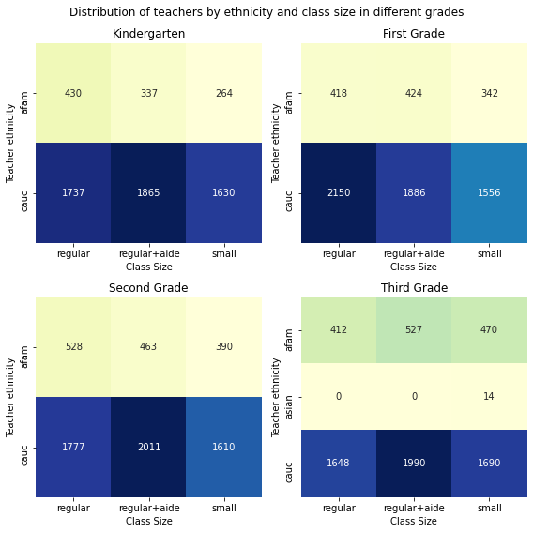
Plot:
Teachers Ethnicity in different grades.
“Cauc” is the most common ethnicity across all categories.

Slide 28
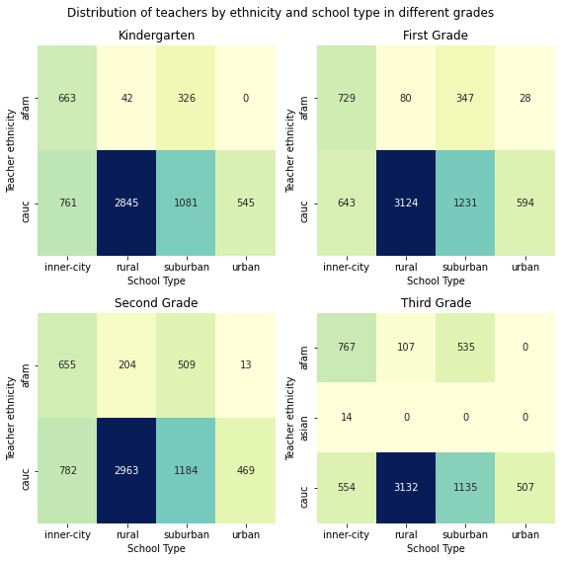
Plot:
Teachers by Ethnicity and school type in
Different grade.
In Rural, suburban, urban categories the highest number of teachers were “Cauc”.
For Inner-city school type, in Kindergarten, second grade “Cauc” was the most common ethnicity but in 1st,3rd grade afam was most common.

Slide 29
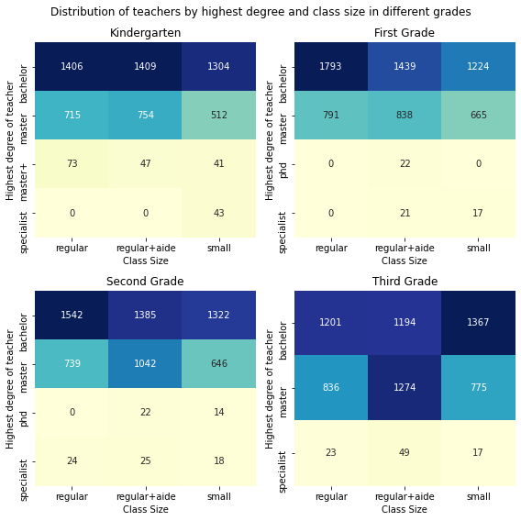
Plot:
Teachers by highest degree in various class and grades.
Bachelor’s is the most common degree among all categories.

Slide 30
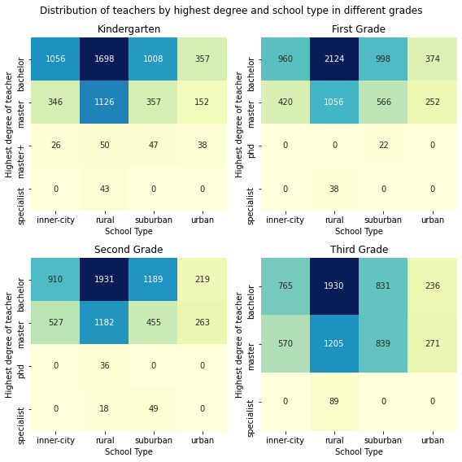
Plot:
Teachers' degree and school type in different grades.
Bachelor's was the common degree across all categories, except for second , third grade in urban regions.

Slide 31
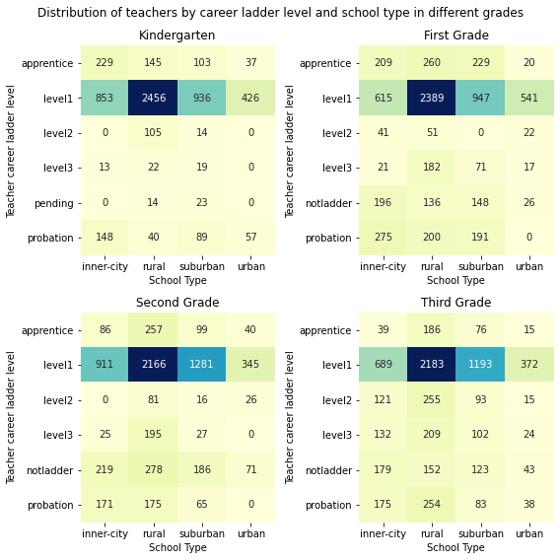
Plot:
Teachers Career Ladder Level in school’s grades
“Level 1” career ladder level is the most common among all the categories.

Slide 32
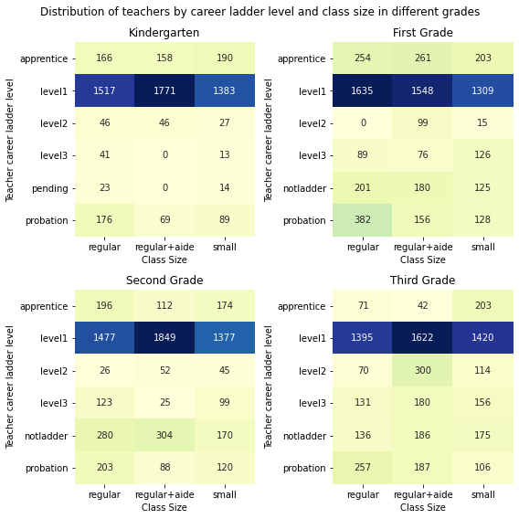
Plot:
Career ladder level for teachers for classes.
Level 1 is the most common career ladder across all categories.

Slide 33
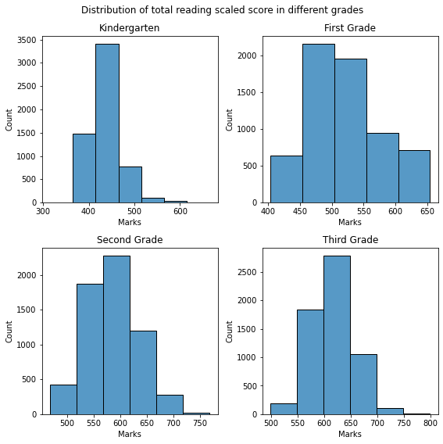
Plot:
Total Reading scores in different grades
Kindergarten most marks were in the range of approximate 400 -500.
Similarly, first grade students got marks between roughly 450- 550.
Likewise, Second grade students marks are between about 550 – 650.
Third grade students got between almost 550 – 650 .

Slide 34
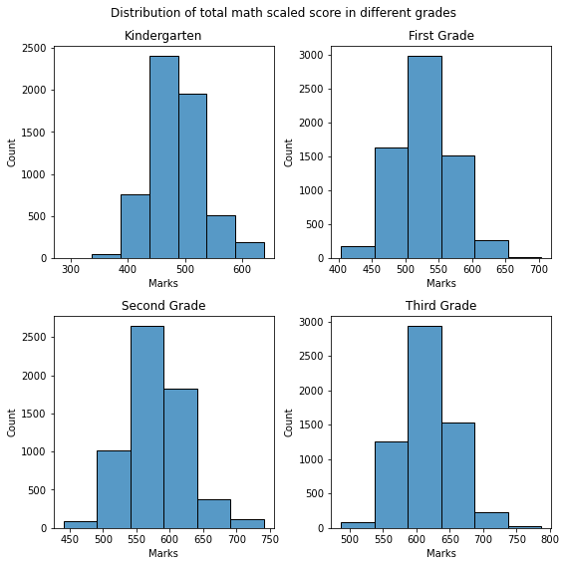
Plot:
Total math score in Different grades
Kinder garden students got their math's between
450 – 550 approximately.
The first grade pupil got between 500 – 600 marks.
Similarly, Second and third students got almost
550 – 650 marks in total.

Slide 35
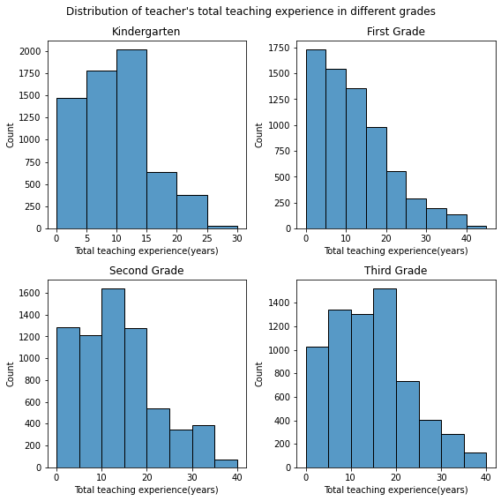
Plot:
Total Teaching experience for different grades.
Teachers teaching in kindergarten mostly have 10 to 15 years of experience.
First grade teachers have experience between < 5 years.
Second grade instructors have almost 10 – 15 years of experience.
Lastly, Third grade teachers have the most of 15 -20 years of experience .

Slide 36

I appreciate your Considerations!

Slide 37
Second Submission

Slide 38

Data Cleaning &Transformation.
Deleted the redundant column Unnamed: 0 from the data frame, as it contained no useful information.
Dropped the rows where no marks data present. Since the data analysis is based on marks as output, rows with no marks data are not useful and have been dropped. Total 812 such rows were dropped from the data frame.
Checked the data for duplicates, no duplicate records were found.
Deleted the unused columns which play no role in our data analysis. Total 12 such columns were deleted.
Created new columns for total marks for each grade, by adding the marks of different subjects. The 4 columns created are: totalk,total1,total2 and total3.
Removed outliers from the data as discussed in the next slides.

Slide 39
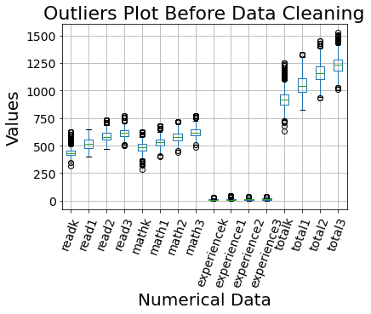
Removing Outliers
All the numerical data columns except read1 had outliers
These outliers were removed as part of data cleaning as shown in the next slide.

Slide 40
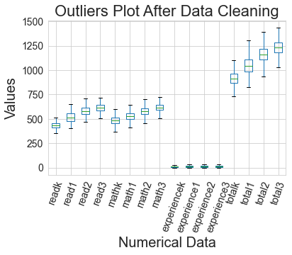
As seen in the plot, no outliers are present after data cleaning.

Slide 41

Data Analysis

Slide 42
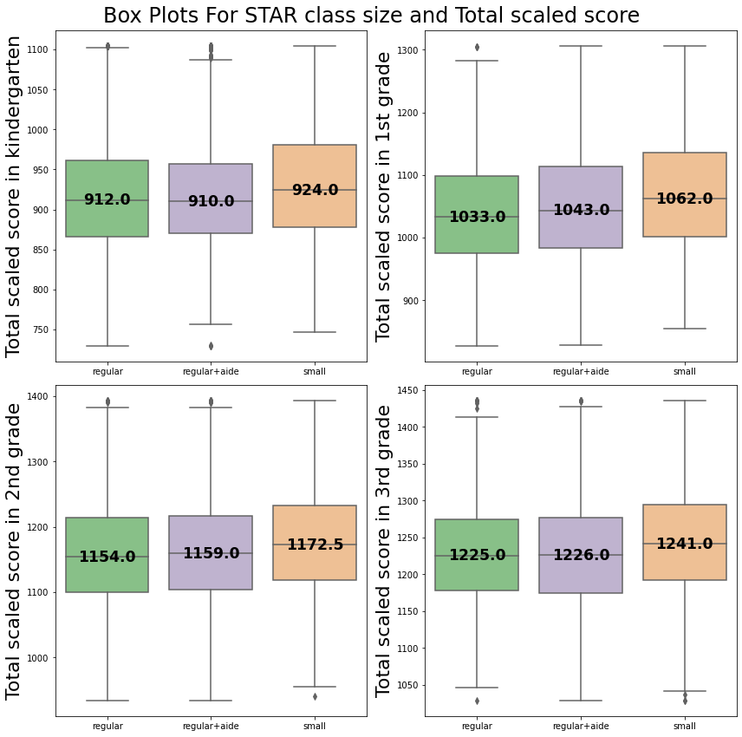
How does the class size impact overall student marks?
We can see that across all the grades, students in the class with small size scored the highest.

Slide 43
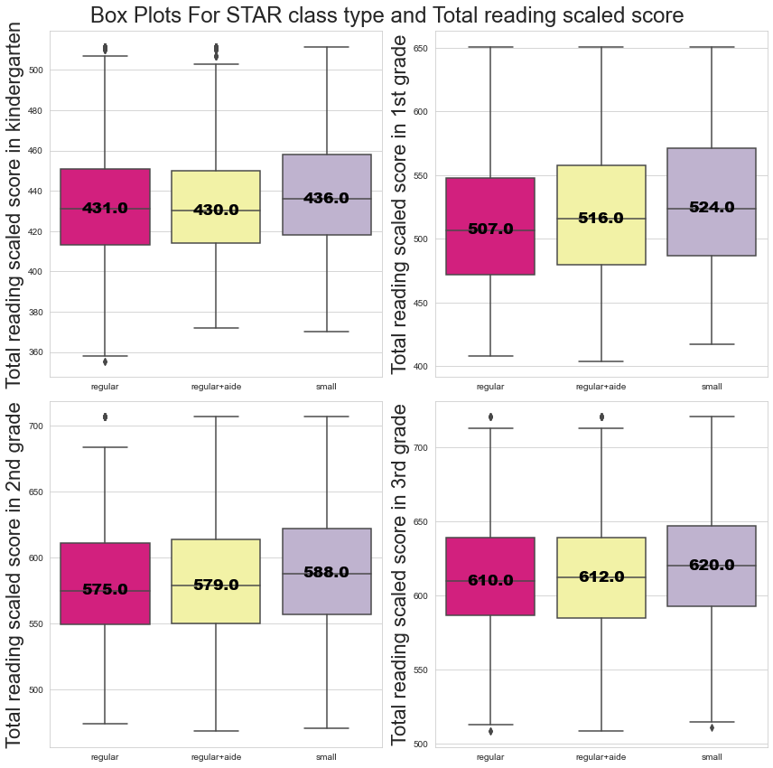
What is the impact of class size on different subjects like mathematics and reading?
Small class size indicate better marks for both reading as well as mathematics, as observed from the plots for each grade.

Slide 44
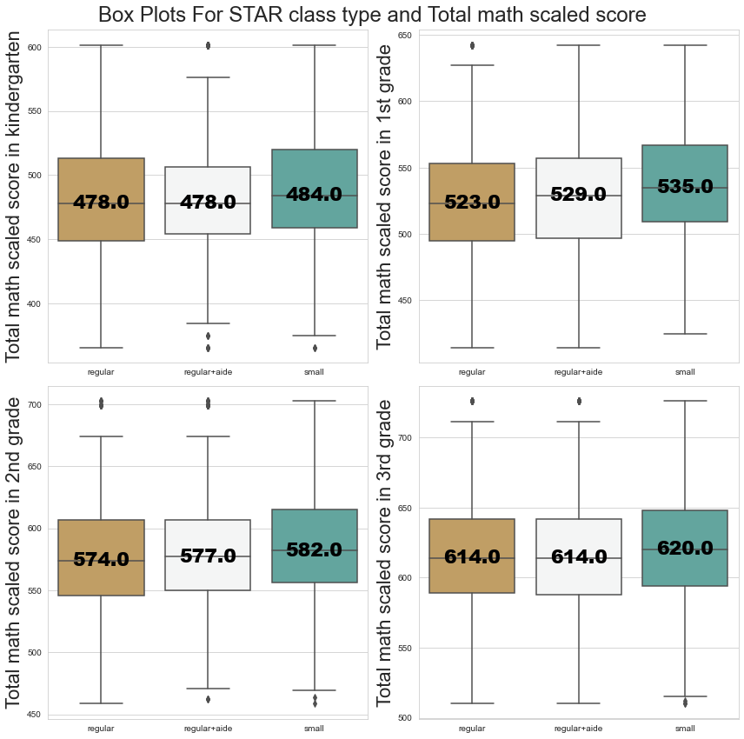
Continued from Previous Question.

Slide 45
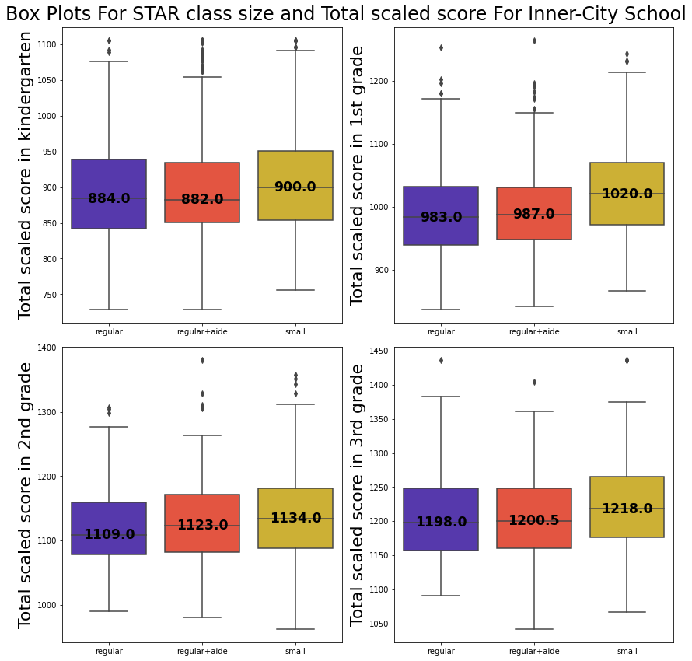
Which school types are benefitted from smaller class size?
All the school types are benefitted from smaller class size for each grade, as small class size meant better score.

Slide 46
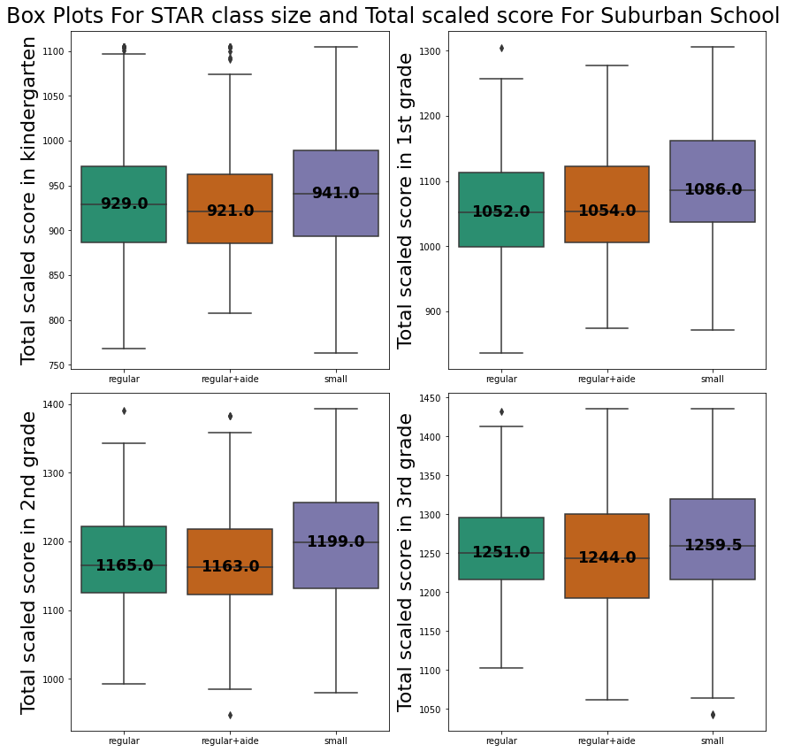
Continued from Previous Question_1.

Slide 47
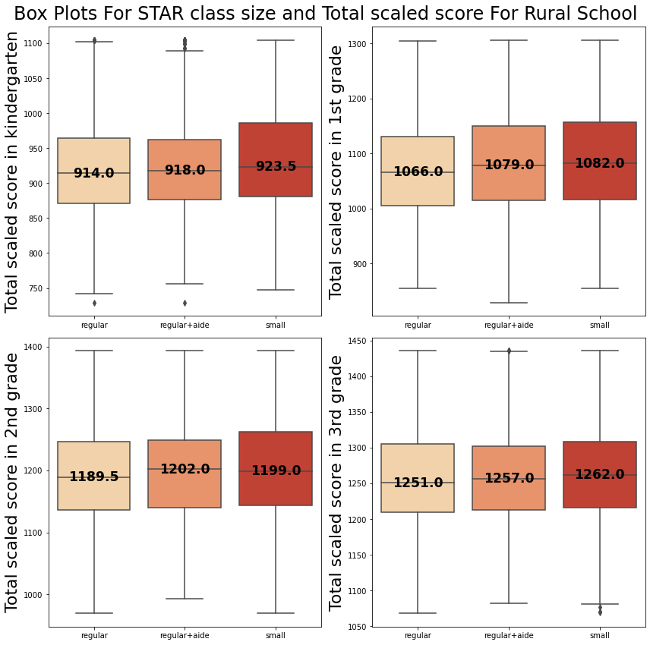
Continued from Previous Question_2.

Slide 48
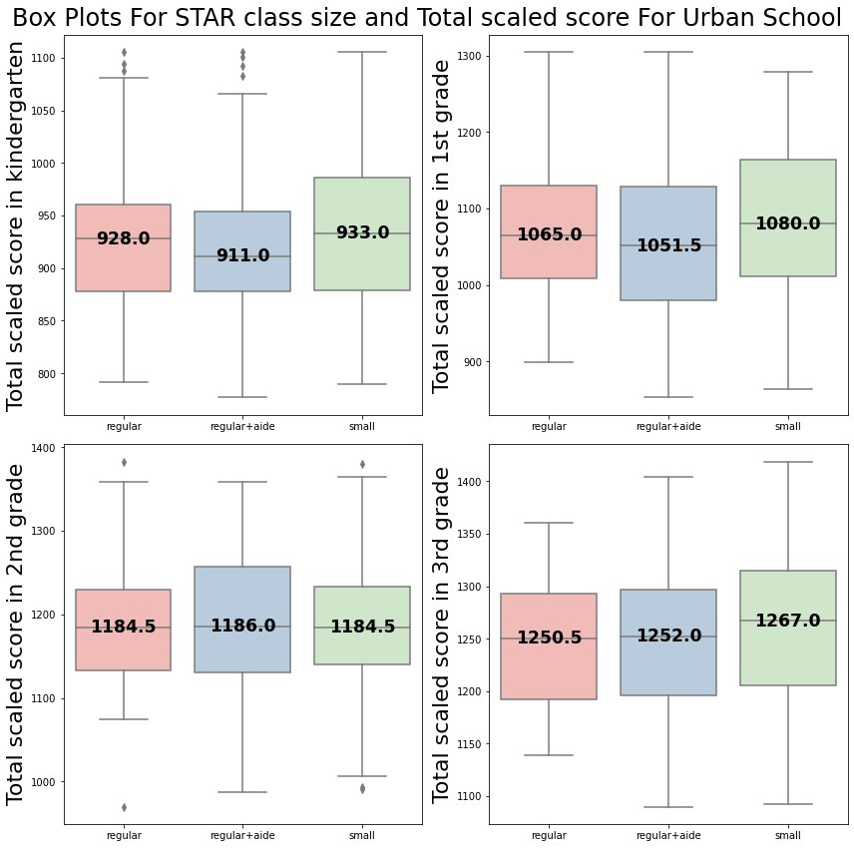
Continued from Previous Question_3.

Slide 49
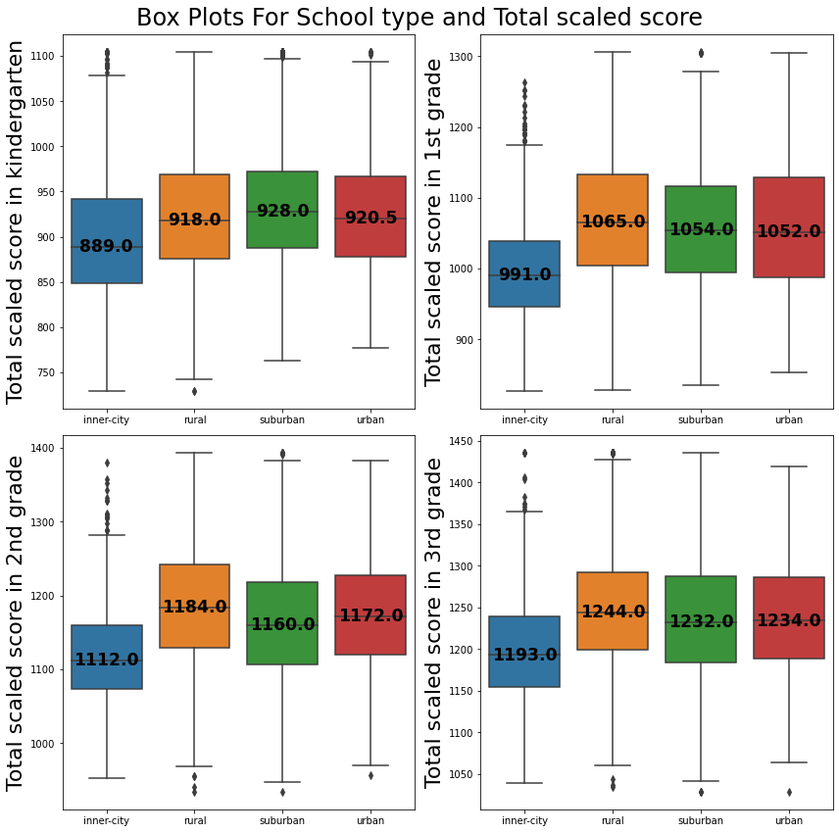
What is the impact of school type on
student marks?
Across all the grades, children in inner-city schools scored the lowest, while urban schools had the highest score for all grades except kindergarten.

Slide 50
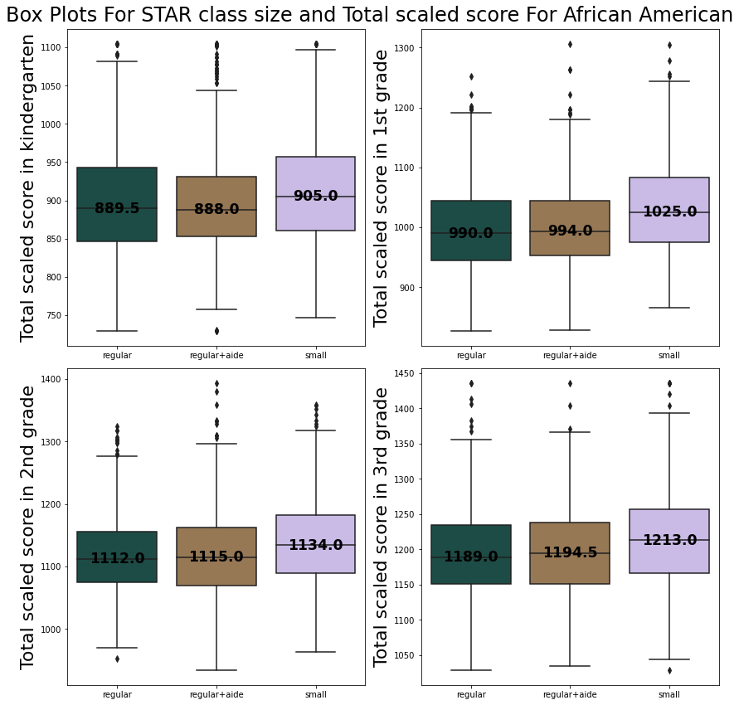
Which ethnicities are benefitted from smaller class size?
From the plots, African American, Caucasian and Other ethnicity students benefit from small class size.
Asian and American Indian students did not gain from small class size.
Also, Hispanic students were assisted from small class size for 1st grade but not for 2nd grade.

Slide 51
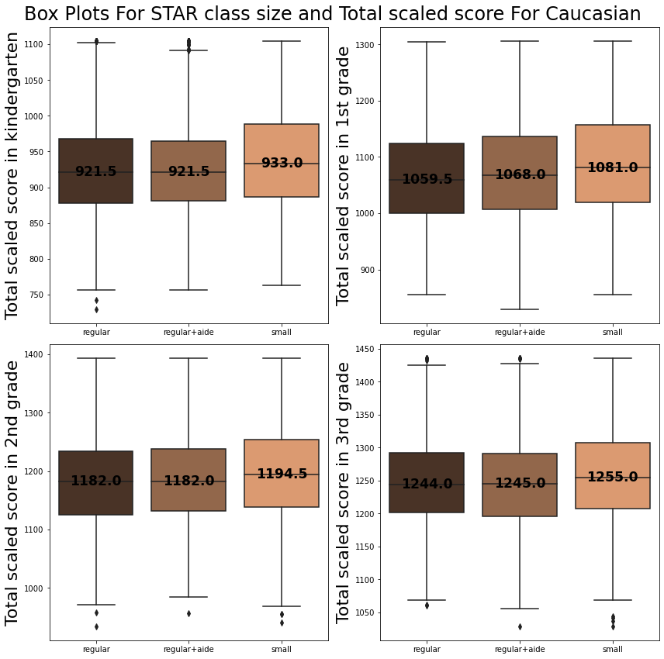
Continued from Previous Question_1.

Slide 52
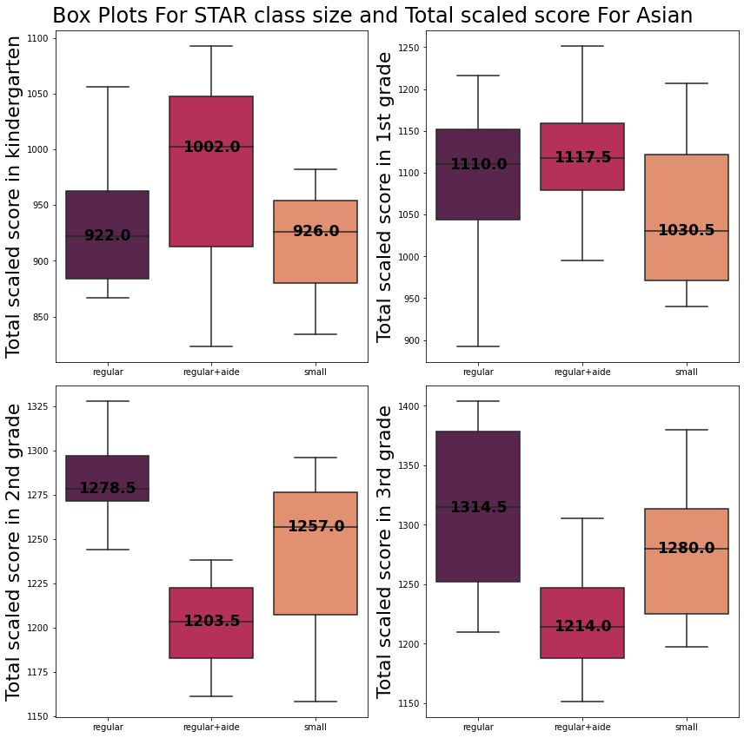
Continued from Previous Question_2.

Slide 53
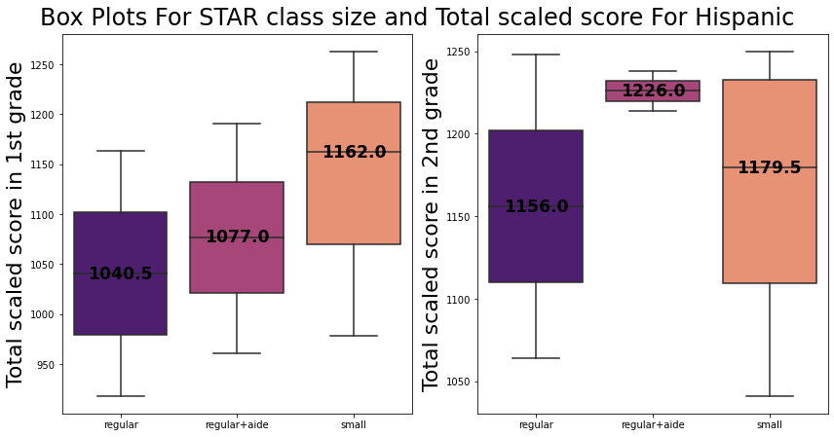
Continued from Previous Question_3.

Slide 54
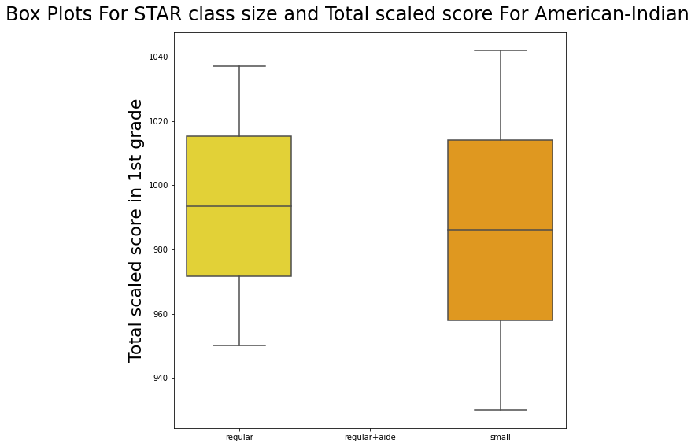
Continued from Previous Question_4.

Slide 55
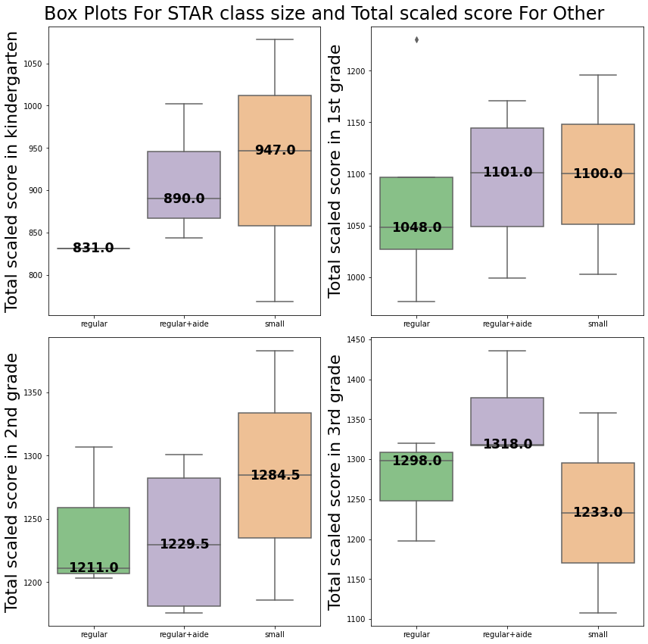
Continued from Previous Question_5.

Slide 56
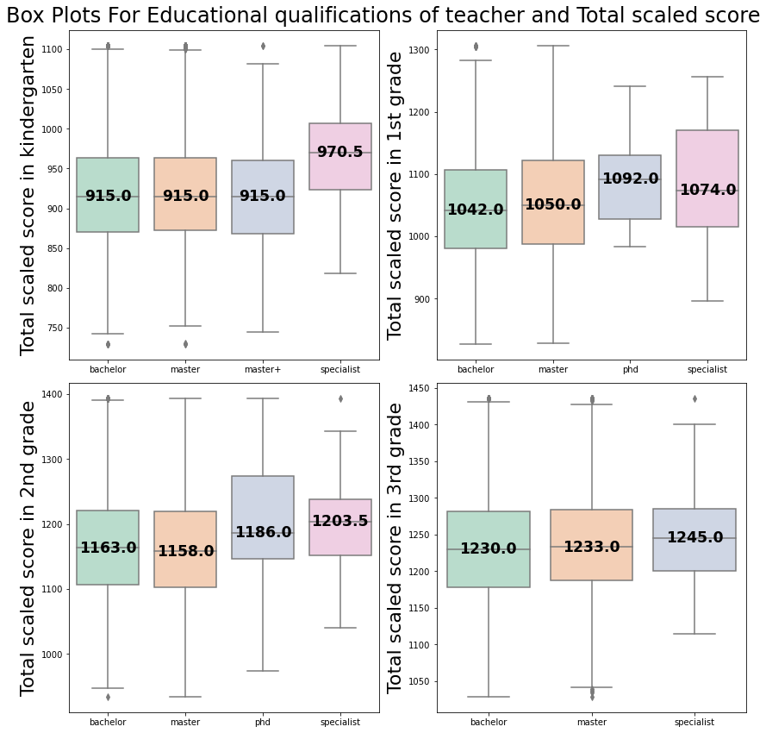
How does the educational qualifications
of teacher affect the student marks?
With increase in educational qualifications of teacher, student marks generally increase.
PhD and Specialist teachers lead to better student marks in comparison to teachers with bachelors or masters degrees.

Slide 57
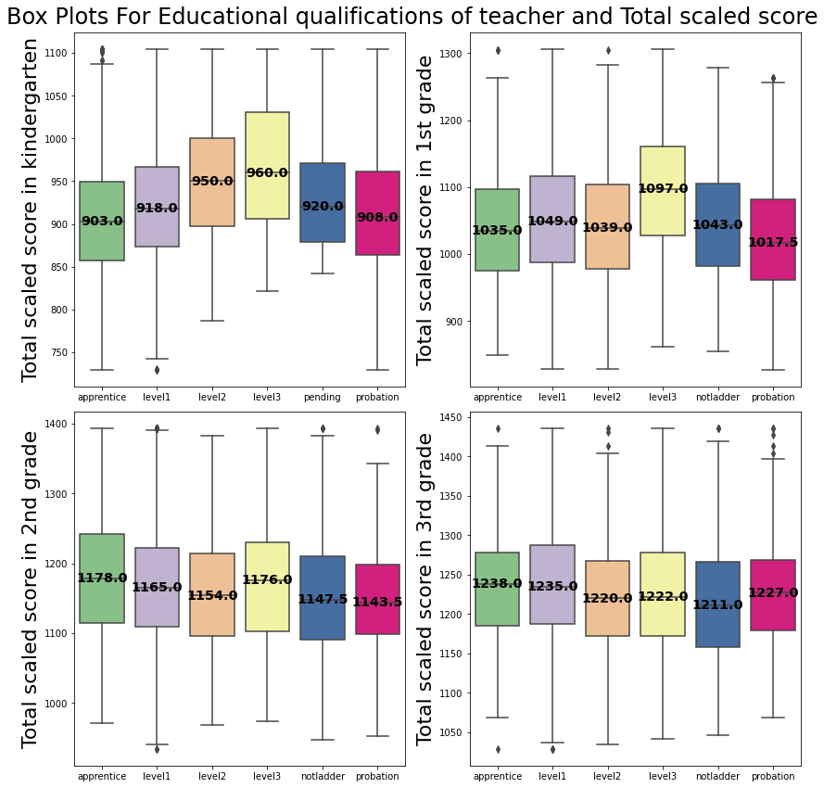
What is the impact of teacher’s career
ladder level on the student marks?
For Kindergarten and 1st grade, Level 3 teachers lead to better student score, in comparison to Level 1 and Level 2 and lower teacher career ladder levels like apprentice and probation.
But for 2nd and 3rd Grade, a uniform relation is not observed between career ladder level and student marks, as even lower career ladder levels like Apprentice lead to better student marks.

Slide 58
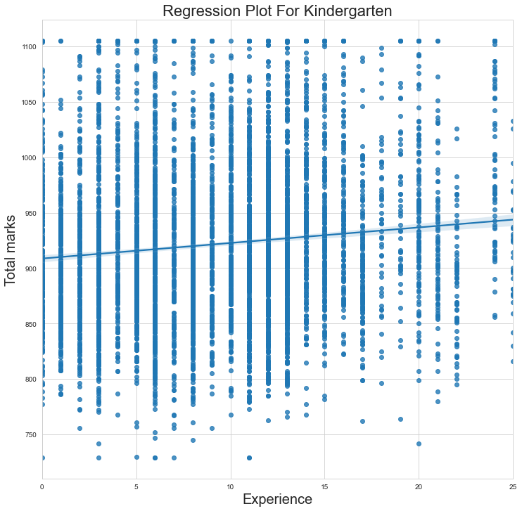
What is the relationship between teacher's total teaching experience and student marks?
From the Regression plots for each grade, we can see that the slope of the regression line decreases as the grade increase from Kindergarten to 3rd Grade.
This means that students in lower grades such as Kindergarten benefit from being taught by experienced teachers, but as the grade increases the effect of teacher experience on student marks becomes negligible.

Slide 59
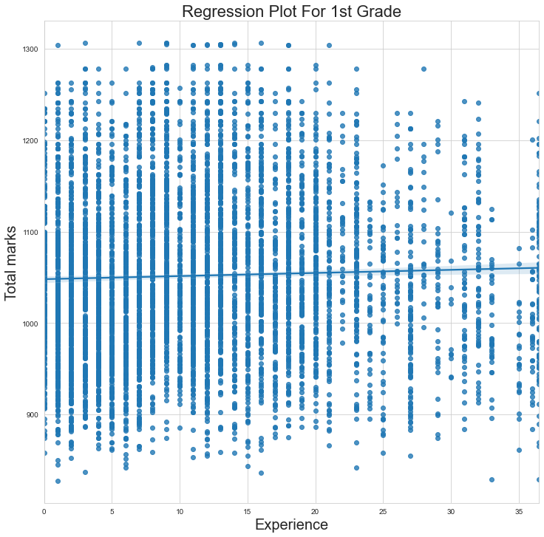
Continued from Previous Question_1.

Slide 60
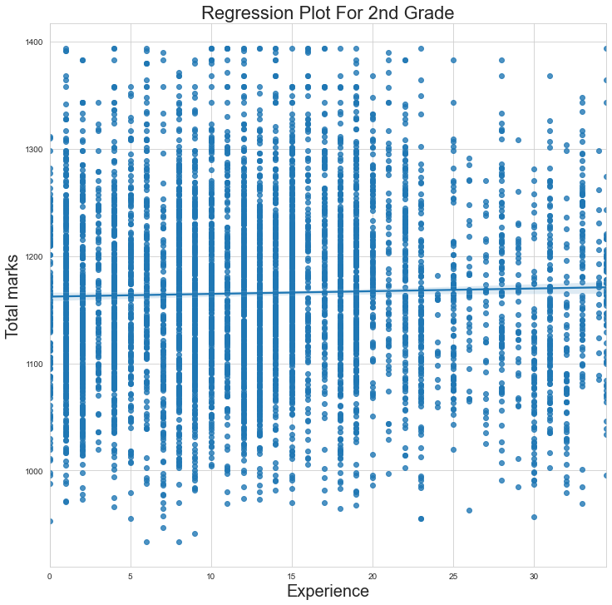
Continued from Previous Question_2.

Slide 61
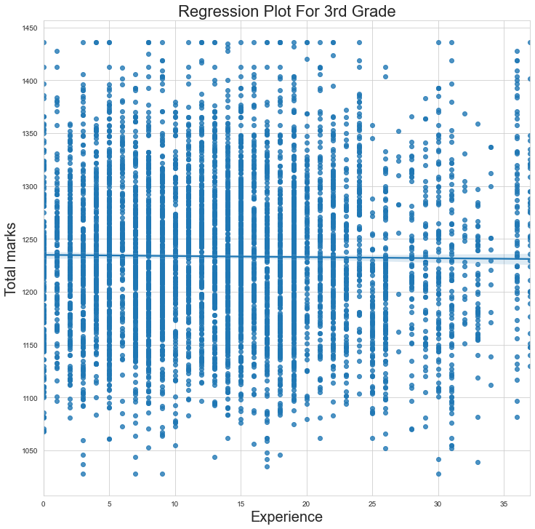
Continued from Previous Question_3.

Slide 62
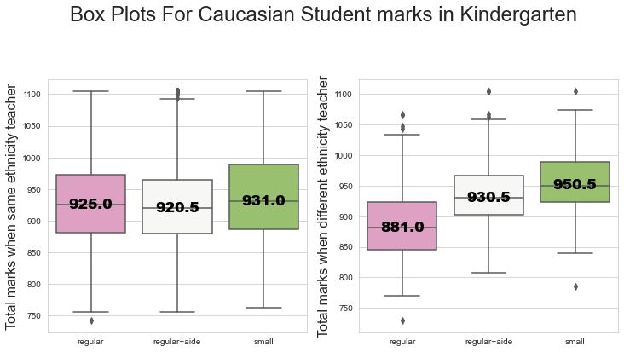
Do students benefit from being taught by the teacher of same ethnicity as theirs?
Generally, students do well when being taught by the teacher of same ethnicity in comparison to being taught by teacher of different ethnicity, with a few exceptions being present.

Slide 63
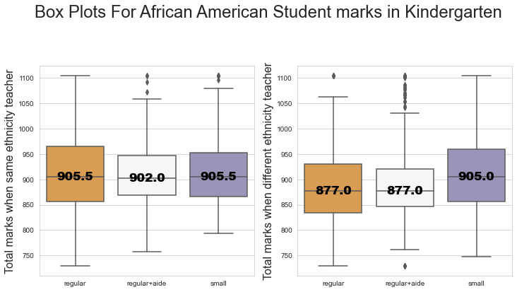
Continued from Previous Question_1.

Slide 64
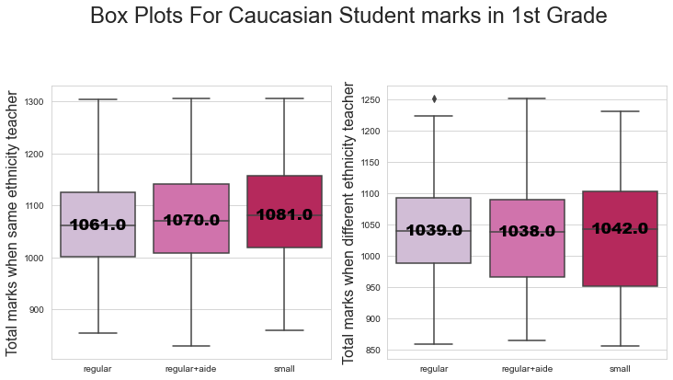
Continued from Previous Question_2.

Slide 65
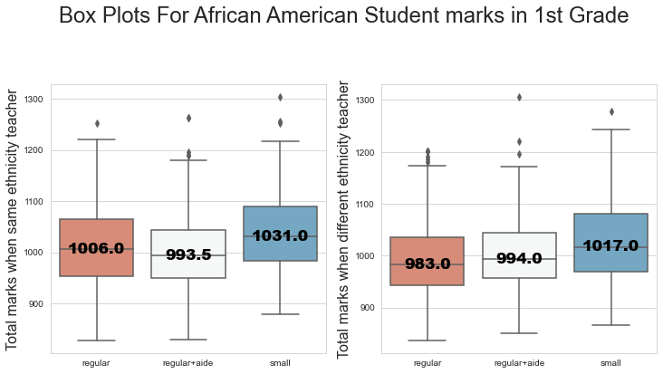
Continued from Previous Question_3.

Slide 66
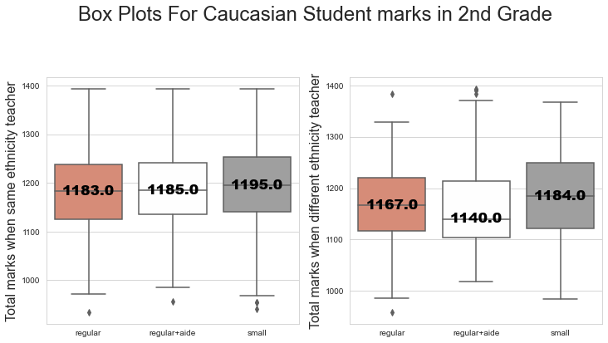
Continued from Previous Question_4.

Slide 67
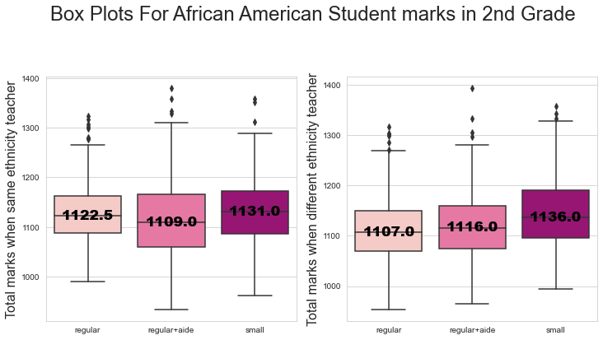
Continued from Previous Question_5.

Slide 68
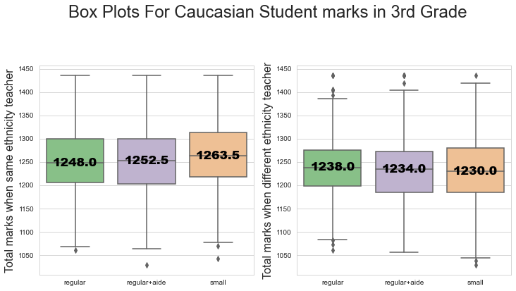
Continued from Previous Question_6.

Slide 69
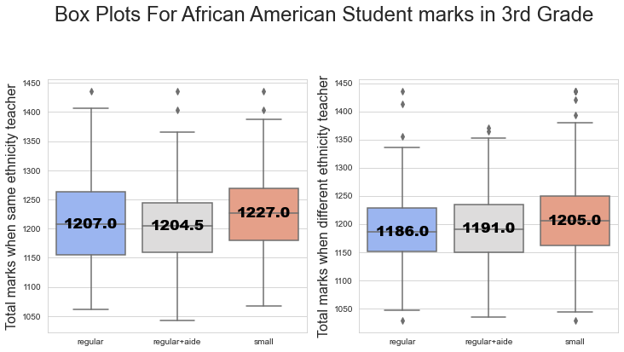
Continued from Previous Question_7.

Slide 70

Is a particular gender more benefitted from smaller
class size?
From the plots, small class size is beneficial for both the genders.

Slide 71

Continued from Previous Question_1.

Slide 72

Continued from Previous Question_2.

Slide 73

Continued from Previous Question_3.

Slide 74

Conclusions
Small class size leads to better student marks across all grades(kindergarten,1st grade,2nd grade,3rd grade) and subjects(mathematics, reading).
All school types inner-city, suburban, rural and urban benefit from small class size.
Inner city schools had the lowest output as opposed to urban schools which had the highest output marks.
Amongst the different communities analyzed, students belonging to African American and Caucasian communities' benefit from small class size.
PhD and Specialist teachers lead to better student marks in comparison to teachers of other qualifications.
Kindergarten and 1st grade students benefit from being taught by teacher of higher career ladder level.
Students in Kindergarten benefit from being taught by experienced teachers.
Students do well when being taught by the teacher of same ethnicity in comparison to being taught by teacher of different ethnicity.
Both gender students benefit from small class size.

Slide 75

Recommendations
Class size should be reduced to 13 to 17 students per class, for Kindergarten,1st Grade,2nd Grade, and 3rd Grade across all school types, that is inner-city, suburban, rural and urban.
Inner city schools should be provided better assistance in the form of teachers with better educational qualifications such as PhD or Specialist, so that they can score better.
African American and Caucasian community students should receive assistance in the form of small class size.
Higher career ladder level teachers should teach Kindergarten and 1st grade.
Experienced teachers should teach Kindergarten students.
Same ethnicity teachers could be allotted for low scoring students that require assistance.

Slide 76

GitHub Repo. & dataset links.
GitHub Repository:
https://github.com/dilpresingh/dab103-project/blob/main/project-submission-2.ipynb
The final python file is uploaded by one of our group member on GitHub Repository.
Weblink to the dataset:
https://vincentarelbundock.github.io/Rdatasets/csv/AER/STAR.csv
https://vincentarelbundock.github.io/Rdatasets/doc/AER/STAR.html
Both Dataset and Summary weblinks are mentioned in this slide.

Slide 77
References
https://dataverse.harvard.edu/dataset.xhtml?persistentId=hdl:1902.1/10766
https://rdrr.io/cran/AER/man/STAR.html
https://cran.r-project.org/web/packages/STAR/STAR.pdf
https://www.sesp.northwestern.edu/docs/publications/1221908847551f03b764dbd.pdf
https://dataverse.harvard.edu/file.xhtml?fileId=666707&version=1.0
Project STAR – Wikipedia
Note: We have denoted the Slides via numeric identification according to references index.

Slide 78

End of Project Two!

